Slide 1
Logical functions transformation into quantum circuits
Anvar Adylov

Slide 2
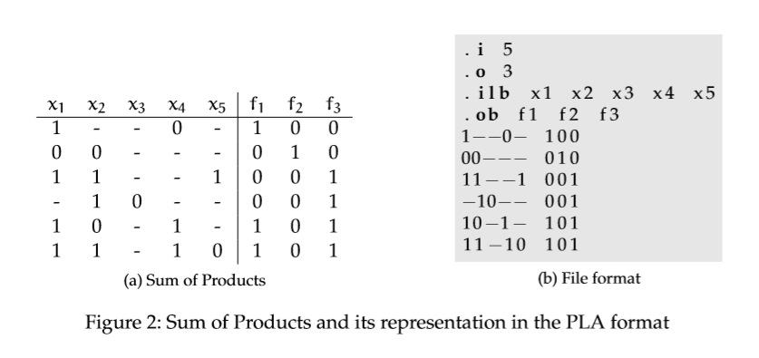
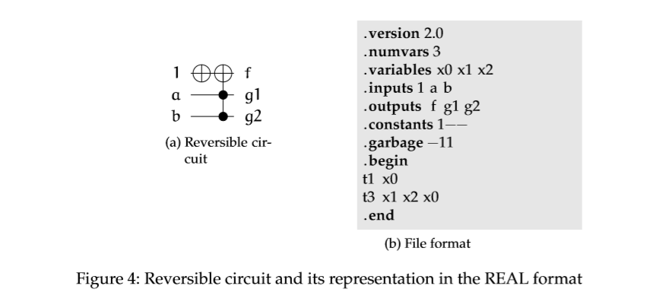
Introduction

Slide 3
Motivation
It’s a huge advantage in the field of quantum computing if you have a program that can create optimal cost-effective circuits for quantum computers which will result in more accurate results since less error will accumulate.
Since classical programming is based on logical gates such as AND, OR and etc. it will allow us to write quantum analogues of classical circuits that exist.

Slide 4
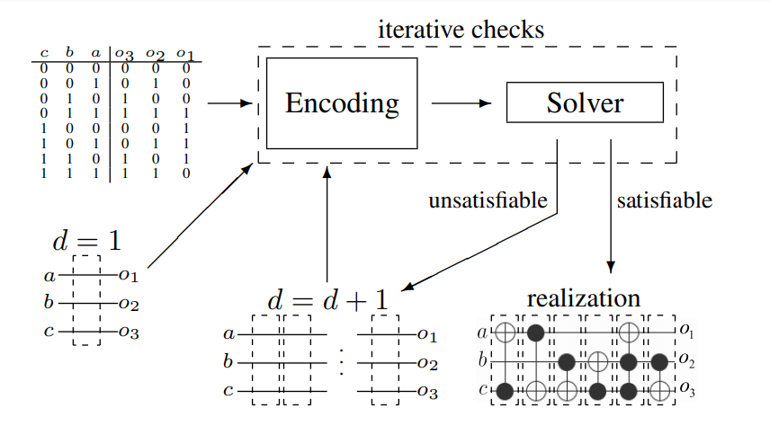
Solution - code

Slide 5

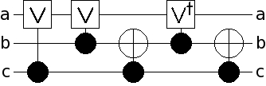
Toffoli gate
If first 2 both 1 flips the target’s value
Can be achieved in quantum via the circuit below
Costs 5

Slide 6
Difficulties
Creating a list of possible quantum logical gates that program can use in order to decompose toffoli gate as a database that can be edited and expanded by user
Logical functions translation to the circuit with elimination of redundant gates
Analysis of the multiple control toffoli gates and finding optimal combination of the simple quantum logical gates

Slide 7
Results
The program that can read a logical function from pla file and if its consists of simple quantum logical gates it can list them but not for complex algorithms that consist of toffoli gates that controlled by more than 2 variables.

Slide 8
Future prospects
Complete the program so it can solve more complex logical algorithms that can have multiple solutions.
Add the database that users can expand that is used to create a quantum circuit.
Make the program to be able to count the efficiency of the circuit so it can choose the most efficient one.

Slide 9
Thank you for your attention

Slide 10
References
Revlib – File Format Documentation
Robert Wille, Hoang M. Le, Gerhard W. Dueck, Daniel Große: Quantified Synthesis of Reversible Logic. Design, Automation and Test in Europe, 2008
Daniel Große, Robert Wille, Gerhard W. Dueck, Rolf Drechsler: Exact Synthesis of Elementary Quantum Gate Circuits for Reversible Functions with Don't Cares. Int'l Symp. on Multi-Valued Logic, 2008
T. Toffoli: Reversible Computing. Automata, Languages and Programming, 1980

